Slide 1

Secure Software Development

Slide 2

Secure System Architecture

Slide 3

Launching into Cyber Security

Slide 4
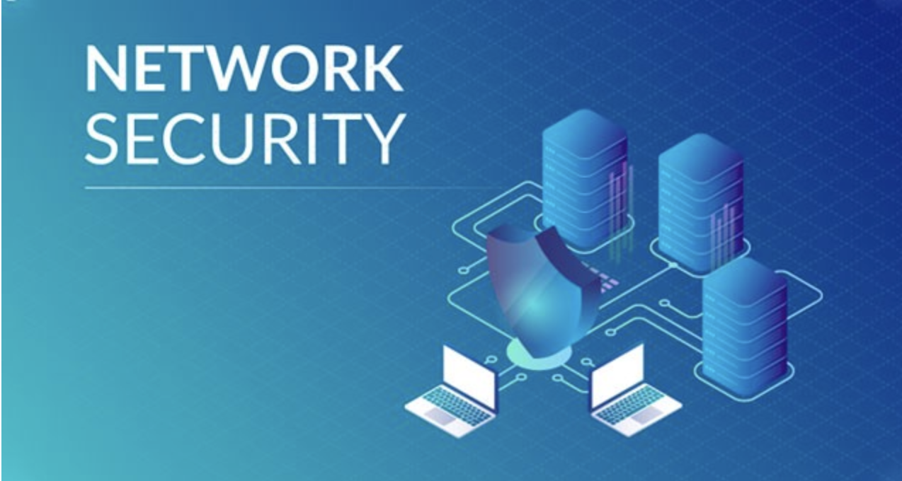

Slide 5

Network Security

Slide 6

Security and Risk Management

Slide 7

Launching into Cyber Security
Launching into Cyber Security

Slide 8

The human factor and principles of digital forensic and cyber law

